Slide 1


The Battle of Neighbourhoods
VS.
Michal Polski

Slide 2
Data Description
We require geographical location data for both London and New York. Postal codes in each city serve as a starting point. Using Postal codes we use can find out the neighbourhoods, boroughs, venues and their most popular venue categories.

Slide 3
Data - London
To derive our solution, We scrape our data from:
https://en.wikipedia.org/wiki/List_of_areas_of_London
This Wikipedia page has information about all the neighbourhoods, we limit it to London only.
borough: Name of Neighbourhood
town: Name of borough
post_code: Postal codes for London
This Wikipedia page lacks information about the geographical locations. To solve this problem we use ArcGIS API

Slide 4
Data – New York
Data Source I (json file):
https://cocl.us/new_york_dataset
Geo-spacial data of the New York to get a better understanding of the neighbourhoods in it and their corresponding locations in the Folium map would make certain things clear for the Project. This will be achieved using the acquired data and visualize the same using Choropleth maps.
Data Source II (json file):
https://cf-courses-data.s3.us.cloud-object-storage.appdomain.cloud/IBMDeveloperSkillsNetwork-DS0701EN-SkillsNetwork/labs/newyork_data.json

Slide 5
Data - Foursquare API
The data is going to be collected/acquired from the Foursquare API about the various venues in each neighbourhood of New York city. Foursquare is a location data provider with information about all manner of venues and events within an area of interest. Such information includes venue names, locations, menus and even photos. As such, the foursquare location platform will be used as the sole data source since all the stated required information can be obtained through the API.
After finding the list of neighbourhoods, we then connect to the Foursquare API to gather information about venues inside each and every neighbourhood. For each neighbourhood, we have chosen the radius to be 500 meters.

Slide 6
Exploratory Analysis
City | No. of Neighbourhoods | No. of Venues | Unique Venues
New York: Manhattan | 40 | 3172 | 333
London | 50 | 10276 | 298
Most common venues for London is Pub and Coffee Shop, for New York it is Italian Restaurant.
Coffee Shops are very common for both cities. Also, New York has many Pizza Places – it is famous for being one of the places where tourists must try New York style pizza.

Slide 7
Clustering (k-Means Model)
k-Means algorithm is an iterative algorithm that tries to partition the dataset into k-pre-defined distinct non-overlapping subgroups (clusters) where each data point belongs to only one group. It tries to make the intra-cluster data points as similar as possible while also keeping the clusters as different (far) as possible. It assigns data points to a cluster such that the sum of the squared distance between the data points and the cluster’s centroid (arithmetic mean of all the data points that belong to that cluster) is at the minimum. The less variation we have within clusters, the more homogeneous (similar) the data points are within the same cluster.

Slide 8
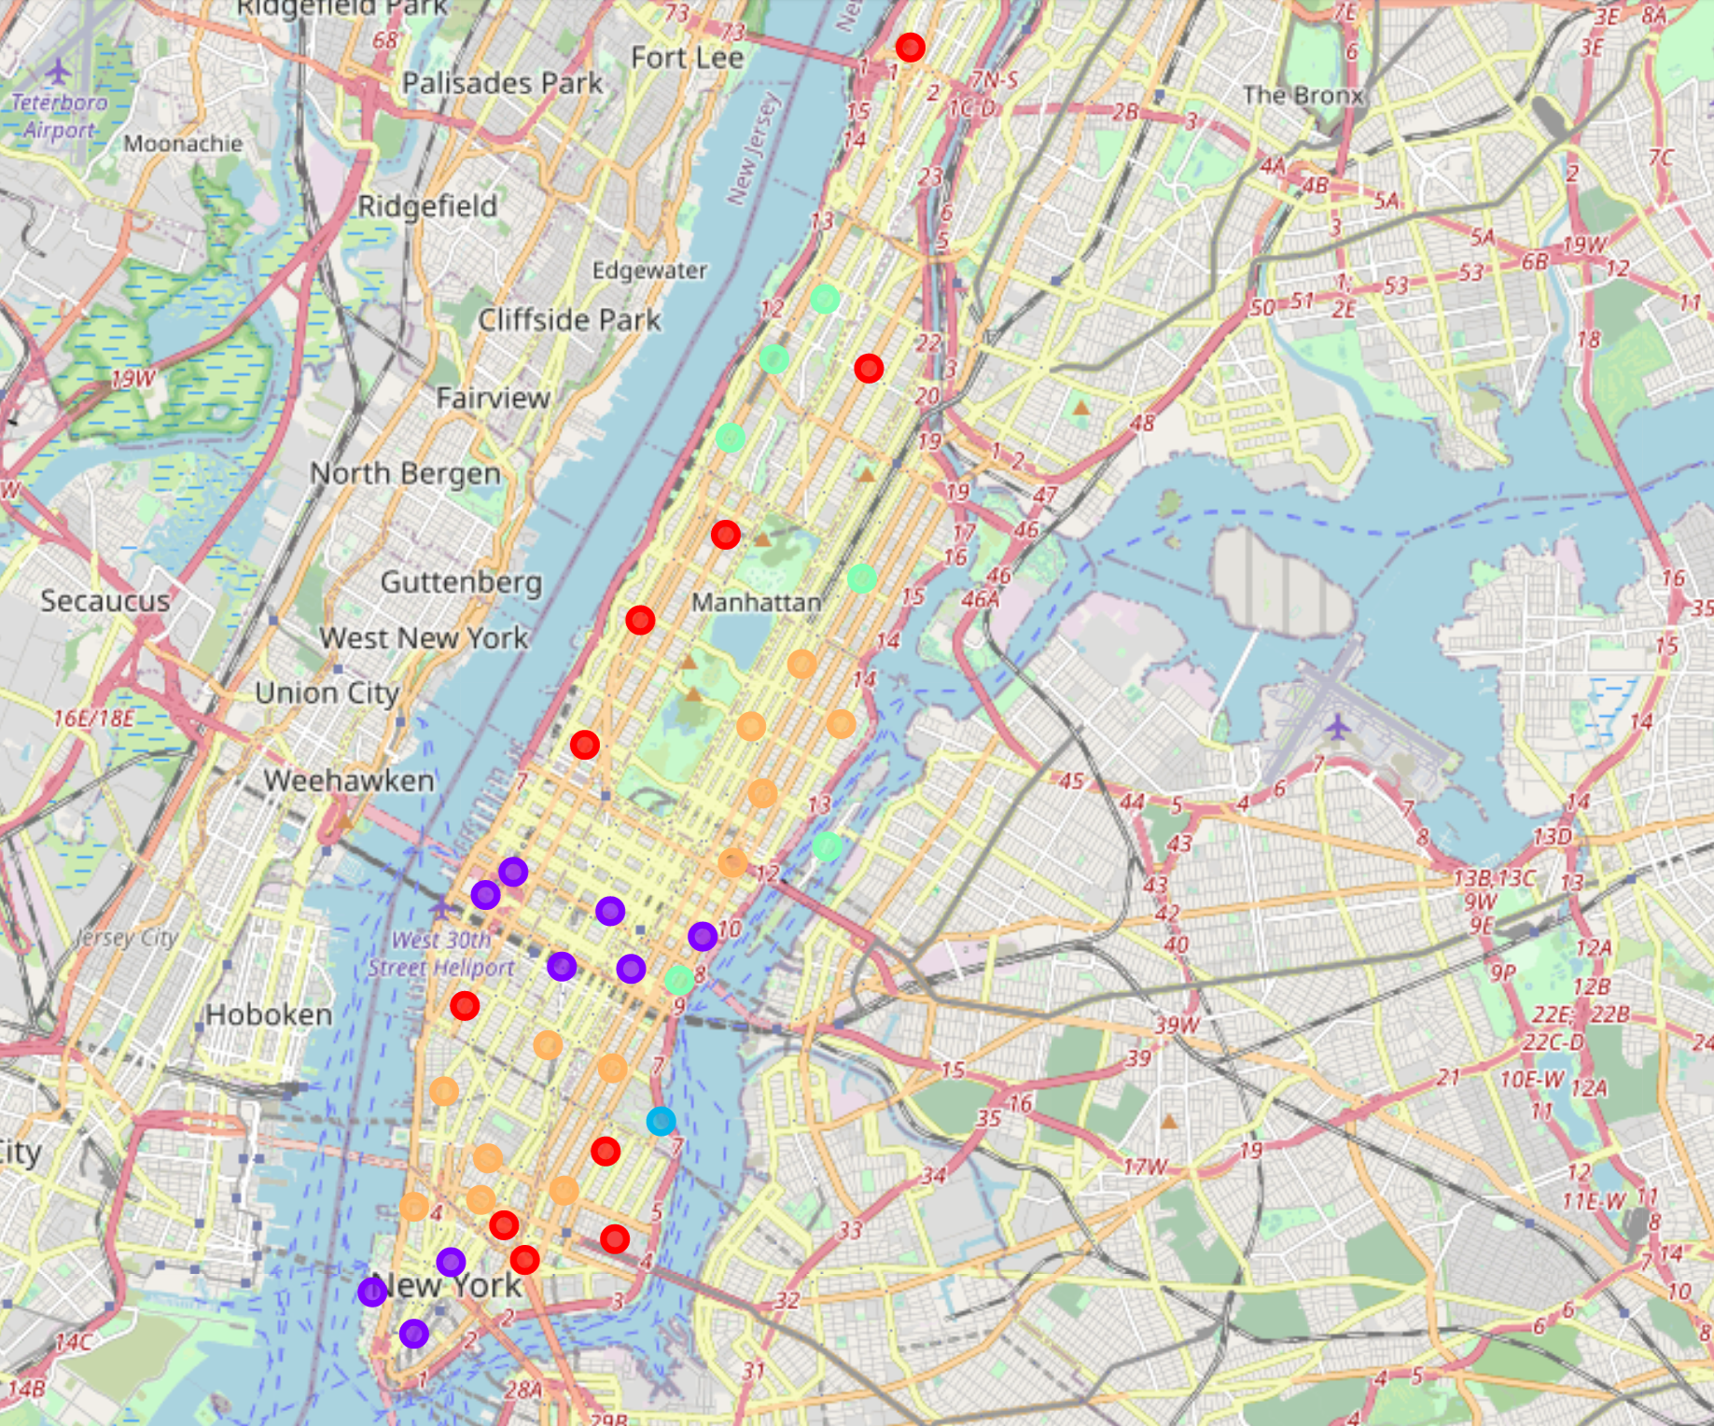
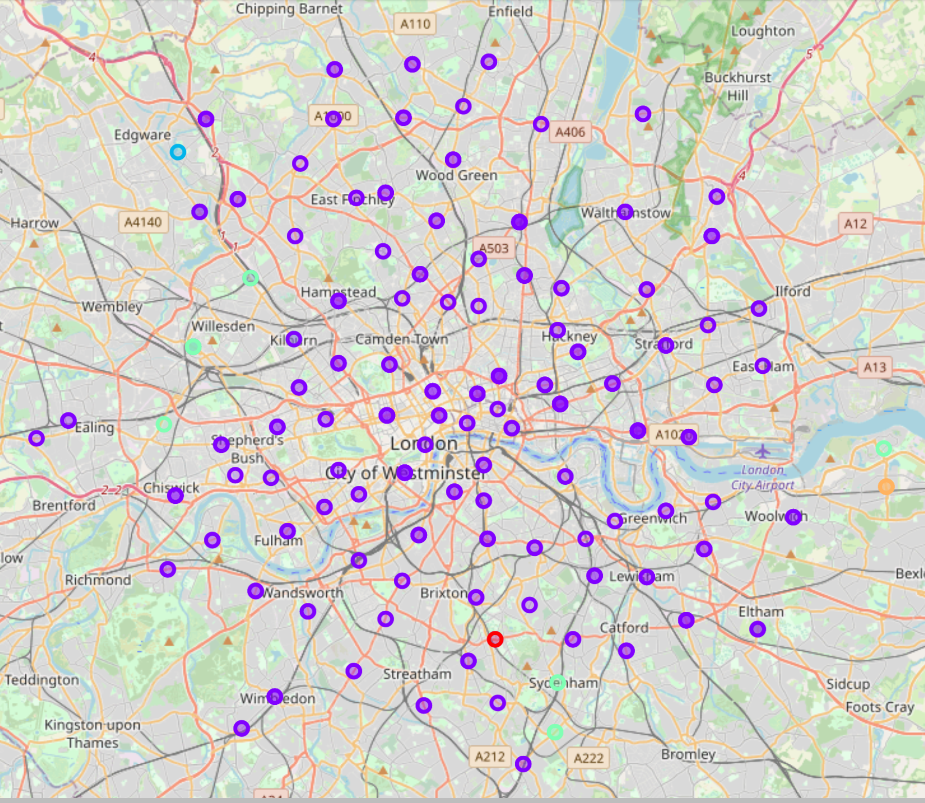
Results (Graphics)

Slide 9
Manhattan – Identified Clusters
Cluster 1 – Leisure Time (Cafe & Restaurants)
Cluster 2 – Tourists and Wellbeing Areas
Cluster 3 – Park Cluster
Cluster 4 - Diverse Areas
Cluster 5 - Italian Restaurant Cluster

Slide 10
London – Identified Clusters
Cluster 1 - Coffee Shops and Pubs (part of the data)
Cluster 2 – Bakery
Cluster 3 - Grocery Store & Indian Restaurant
Cluster 4 – Supermarket & Historic Sites
Cluster 5 – Flower Shop

Slide 11
Discussion / Observations / Recommendations
One of the observations regarding the comparison is that cities are very different. Each city offers very different venues. London is more homogeneous, while, Manhattan is more diverse – the neighbourhoods represent very different sets of venues. Also, London might have more to offer, as the number of venues is about 3 times higher. Additionally, the most common venues for London are: Pubs (very British) and Coffee Shops – people love coffee apparently. For Manhattan, the most popular restaurant is Italian, which is expected, having in mind that New York loves Pizza.
Overall, if you are a tourist, and want to decide where to go, based on our model we can recommend New York for someone who likes diversity and Italian food. If you prefer more convenient city (lots of supermarkets) and you like to have a pint – choose London, its full of pubs.

Slide 12
Conclusions
In this project, we were trying to find out the characteristics of the two cities, neighbourhoods and check how these neighbourhoods cluster.
k-Means model helped us to better understand the landscape of areas in each city, which can help tourists or new comers to choose best district for their taste.
Both cities have so much to offer, but based on the data, analysis and modelling we can conclude some facts around them.
If you are a fan of Italian cuisine and you like variety you should choose New York. If you prefer to spent leisure time in pub, or you value convenience and shop in supermarket – go with London.

